Slide 1
UNIT-III Combinational Logic

Slide 2
Introduction
2 types
  Combinational
    Consists of logic gates whose outputs at any time are determined directly from the present combination of inputs without regard to previous inputs.
  Sequential
    Employ memory elements in addition to logic gates

Slide 3
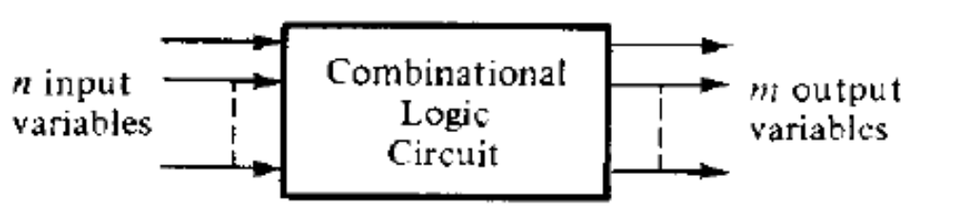
Block diagram of combinational circuit

Slide 4
Design procedure
The problem is stated
The number of available input variables and required output variables is determined
The input and output variables are assigned letter symbols
The truth table that defines the required relationships between inputs and outputs is derived.
The simplified Boolean function for each output is obtained
The logic diagram is drawn

Slide 5
Design Constraints
Minimum number of
- Gates
- inputs to the gates
- interconnections
- propogational delay
Limitations of driving capabilities of each Gate.

Slide 6
Adders
Half adder
  Adds 2 bits
  2 inputs and 2 outputs
Full adder
  Adds 3 bits
  3 inputs and 2 outputs

Slide 7
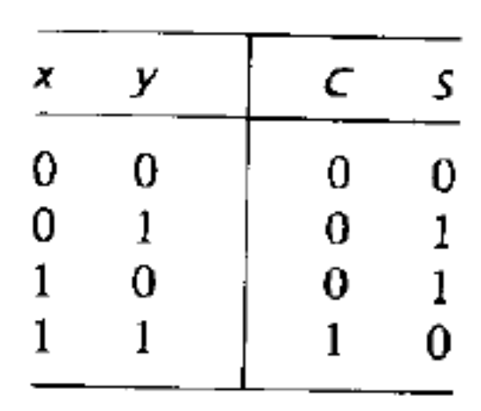
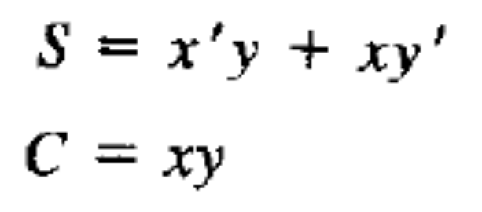
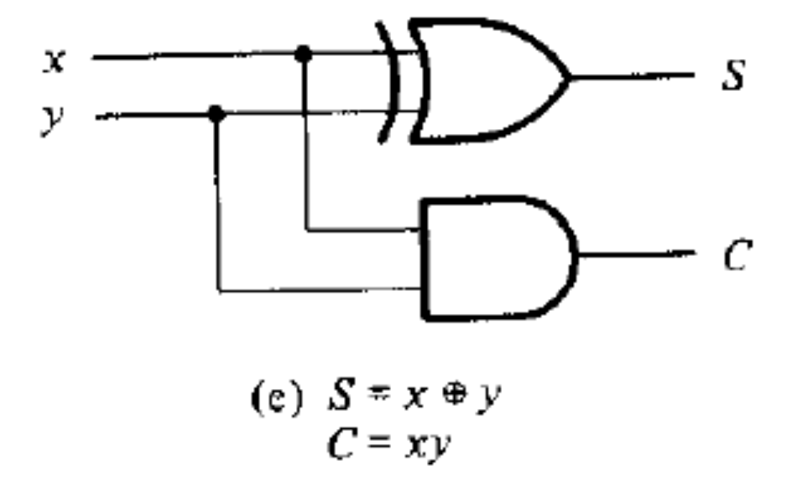
Half adder
Truth Table
Expressions for Sum and Carry
Logic Diagram

Slide 8
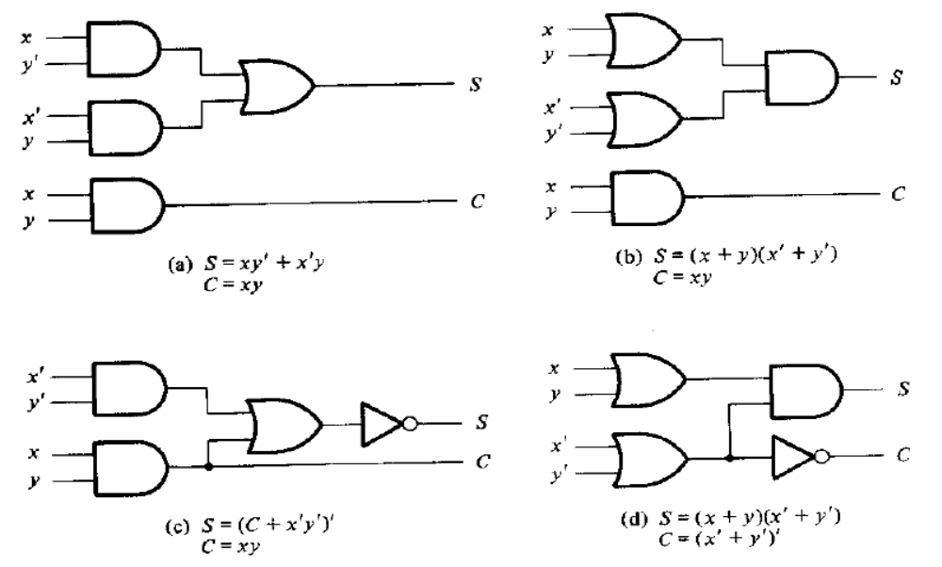
Various implementations of half adder

Slide 9
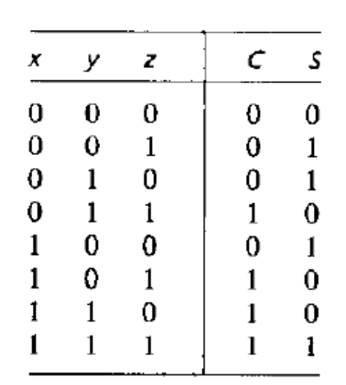
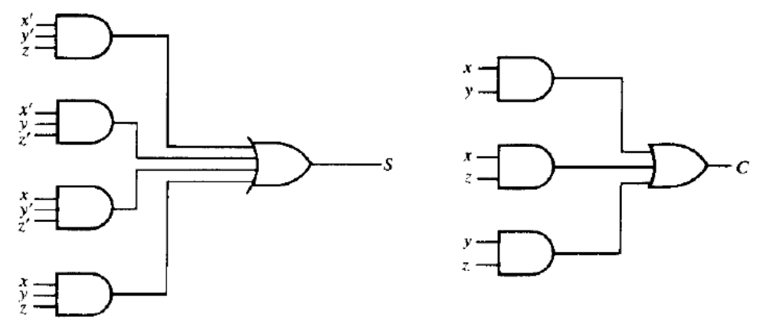
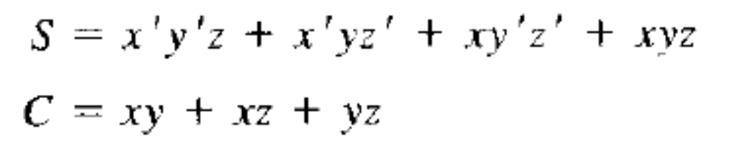
Full adder
Truth Table
Logic Diagram
Expressions for Sum and Carry

Slide 10
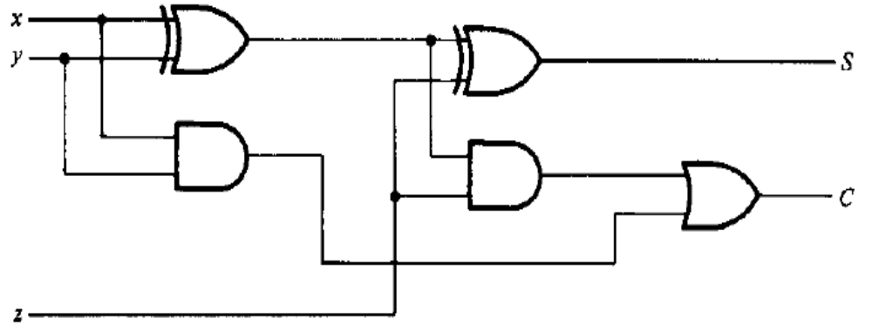
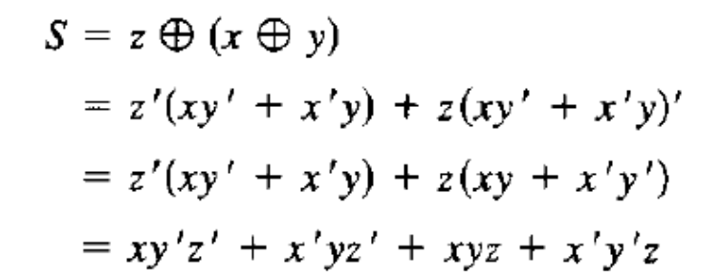
Implementation of Full Adder using 2 half adders

Slide 11
Subtractors
Half Subtractor
  Subtracts 2 bits and provide difference and borrow as outputs.
Full Subtractor
  Subtracts two bits, taking into account that a 1 may have been borrowed by a lower significant stage

Slide 12
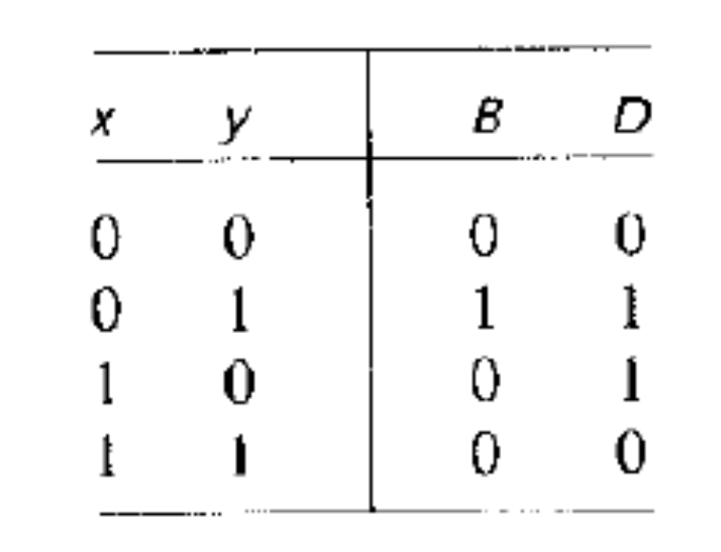
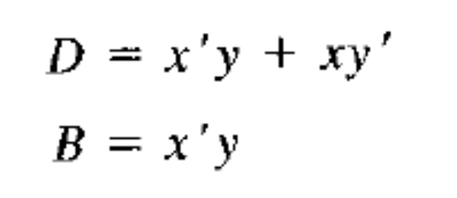
Half subtractor
Truth Table
Expressions

Slide 13
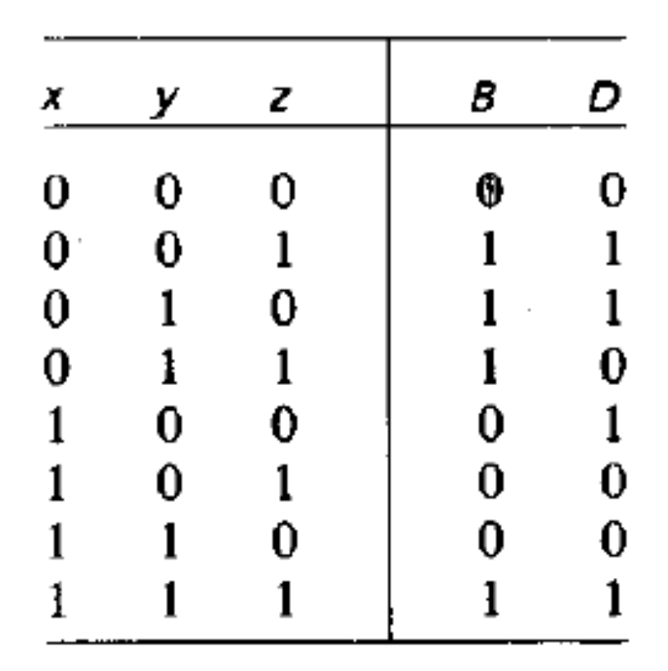
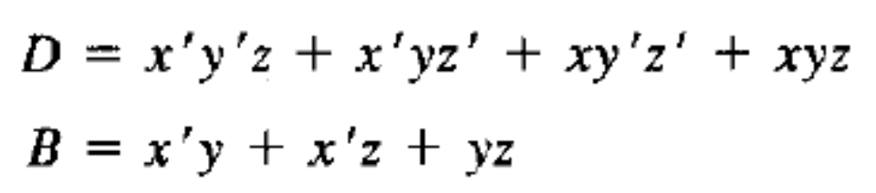
Full Subtractor
Truth Table
Expressions

Slide 14
Subtractor
Design full subtractor using two half subtractor.
Implement the four Boolean functions listed using three half –adders
D = A exor B exor C
E = A′BC + AB′C
F = ABC′ + (A′ + B′)C
G = ABC

Slide 15
Practise Question
Show how a full adder can be converted to a full subtractor with an addition of one inverter circuit.

Slide 16
IV-Google form link
https://forms.gle/o9PSp5jBVJbLfL8o6

